Slide 1
Multiplicative relationships between terms
Expressions and formulae

Slide 2
how to use Oak lessons

Slide 3
I can appreciate that a multiplicative relationship between variables can be written in a number of different ways.

Slide 4
An equation is used to show two expressions that are equal to each other.
A product in algebra is the result of two or more terms multiplied together.

Slide 5

Multiplicative relationships
The structure of multiplicative relationships
Rearranging multiplicative relationships

Slide 6
The structure of multiplicative relationships
This is a visual representation of 4 × 3 = 12
The inverse of ×3 is ÷3
4 × 3 = 12
12 ÷ 3 = 4
3 × 4 = 12
12 ÷ 4 = 3
The inverse of ×4 is ÷4
The commutativity of multiplication.
What other facts does it show us?
You might have heard this called a ‘Fact Family’.

Slide 7
The structure of multiplicative relationships
You might have heard this called a ‘Fact Family’.
4 × 3 = 12
12 ÷ 3 = 4
3 × 4 = 12
12 ÷ 4 = 3
You could also call it the family of rearrangements of the multiplicative relationship 4 × 3 = 12

Slide 8
The structure of multiplicative relationships
You might have heard this called a ‘Fact Family’.
4 × 3 = 12
12 ÷ 3 = 4
3 × 4 = 12
12 ÷ 4 = 3
In algebra you won’t see division facts written like this.

Slide 9
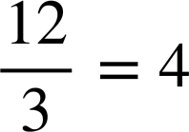
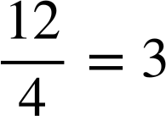
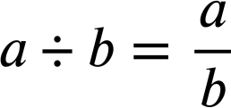
The structure of multiplicative relationships
You might have heard this called a ‘Fact Family’.
4 × 3 = 12
12 ÷ 3 = 4
3 × 4 = 12
12 ÷ 4 = 3
In algebra you will see division facts written with a fraction bar. We use this generalisation:

Slide 10
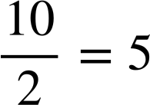
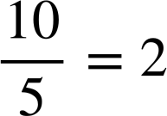
The structure of multiplicative relationships
Complete this family of rearrangements for the multiplicative relationship you see here.
5 × 2 = 10
2 × 5 = 10

Slide 11
The structure of multiplicative relationships
Let’s consider the structure of this family.
5 × 2 = 10
2 × 5 = 10
When we multiply two numbers we can say…
5 × 2 = 10
factor
×
factor
=
product

Slide 12
The structure of multiplicative relationships
Let’s consider the structure of this family.
product
5 × 2 = 10
=
factor 1
factor 2
2 × 5 = 10
product
=
factor 2
factor 1
When we multiply two numbers we can say…
5 × 2 = 10
factor 1
×
factor 2
=
product

Slide 13
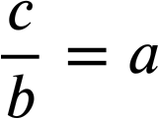
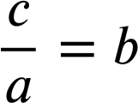
The structure of multiplicative relationships
This allows us to generalise a rule.
a × b = c
b × a = c
A generalisation for rearranging multiplicative relationships.
a, b, and c can take the form of any term be it a number or an algebraic variable.

Slide 14
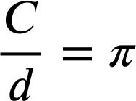
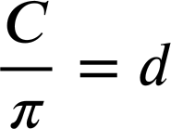
The structure of multiplicative relationships
Complete the family of rearrangements for this multiplicative relationship.
Circumference = π × diameter
C
d
C = π × d
C = d × π
Notice that in both ‘division’ rearrangements that C, the numerator, was the product of the original multiplicative relationship.

Slide 15
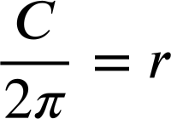
The structure of multiplicative relationships
Sometimes we will need to consider the product of two terms as a term when rearranging.
Circumference = 2 × π × radius
C
C = 2πr
r
C ÷ π = 2πr ÷ π
C ÷ π = 2r
C ÷ π ÷ 2 = 2r ÷ 2
C ÷ π ÷ 2 = r

Slide 16
The structure of multiplicative relationships
Sometimes we will need to consider the product of two terms as a term when rearranging.
Circumference = 2 × π × radius
C
C = 2πr
C = 2πr
r
C ÷ π = 2πr ÷ π
C = r × 2π
C ÷ π = 2r
C ÷ 2π = r × 2π ÷ 2π
C ÷ π ÷ 2 = 2r ÷ 2
C ÷ 2π = r
C ÷ π ÷ 2 = r
This is more efficient.

Slide 17
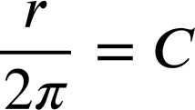

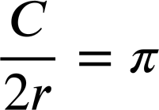

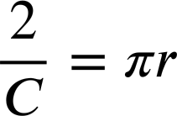
The structure of multiplicative relationships
Which other rearrangement belongs in this family?
C
C = 2πr
r
C = 2πr
C = π × 2r
C ÷ 2r = π × 2r ÷ 2r
C ÷ 2r = π
Note in both correct rearrangements that C, the numerator, was the product of the original multiplicative relationship.

Slide 18
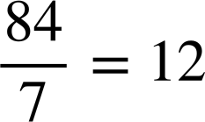
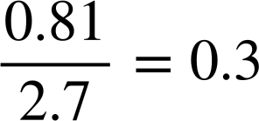
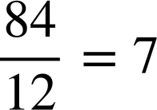
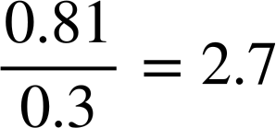
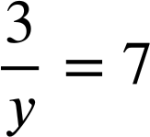
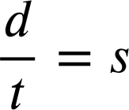
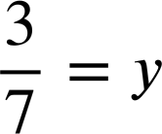
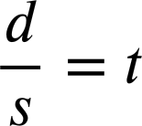
The structure of multiplicative relationships
1) Write the family of rearrangements for the below equations.
a)
b)
12 × 7 = 84
0.3 × 2.7 = 0.81
7 × 12 = 84
2.7 × 0.3 = 0.81
c)
d)
7 × y = 3
d = s × t
y × 7 = 3
d = t × s

Slide 19
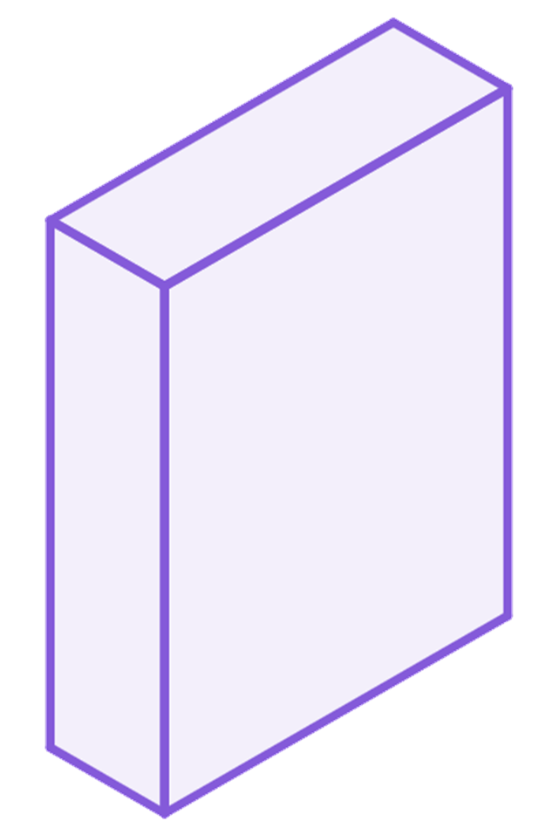
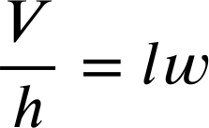
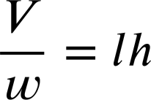
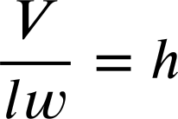
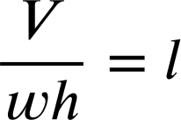
The structure of multiplicative relationships
2) The volume of a cuboid can be calculated as ‘length × width × height’
Fill in the missing parts of these rearrangements.
V = lwh
h
l
w

Slide 20
The structure of multiplicative relationships
1) Write the family of rearrangements for the below equations.
a)
b)
12 × 7 = 84
0.3 × 2.7 = 0.81
7 × 12 = 84
2.7 × 0.3 = 0.81
c)
d)
7 × y = 3
d = s × t
y × 7 = 3
d = t × s

Slide 21
The structure of multiplicative relationships
2) The volume of a cuboid can be calculated as ‘length × width × height’
Fill in the missing parts of these rearrangements.
V = lwh
h
V, the product of the original multiplicative relationship remained the numerator.
l
w

Slide 22
Multiplicative relationships
The structure of multiplicative relationships
Rearranging multiplicative relationships

Slide 23
Rearranging multiplicative relationships
Multiplicative relationships are made up of:
6 × 8 = 48
factor 1
×
factor 2
=
product
We rearrange by first commuting…
Then by doing the inverse of multiplication.
6 × 8 = 48
6 × 8 = 48
8 × 6 = 48
6 × 8 ÷ 8 = 48 ÷ 8
8 × 6 ÷ 6 = 48 ÷ 6
8 × 6 = 48
6 = 48 ÷ 8
8 = 48 ÷ 6

Slide 24
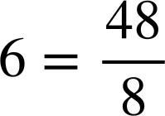
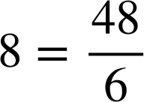
Rearranging multiplicative relationships
Multiplicative relationships are made up of:
6 × 8 = 48
factor 1
×
factor 2
=
product
We rearrange by first commuting…
Then by doing the inverse of multiplication.
6 × 8 = 48
6 × 8 = 48
8 × 6 = 48
6 × 8 ÷ 8 = 48 ÷ 8
8 × 6 ÷ 6 = 48 ÷ 6
8 × 6 = 48

Slide 25
Rearranging multiplicative relationships
Multiplicative relationships are made up of:
6 × 8 = 48
factor 1
×
factor 2
=
product
We rearrange by first commuting…
Then by doing the inverse of multiplication.
6 × 8 = 48
Notice that the product is anchored in the numerator position. The factors change positions.
8 × 6 = 48

Slide 26
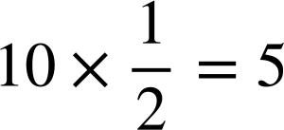
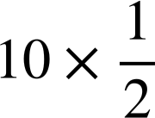
Rearranging multiplicative relationships
Sometimes we have to rearrange from ‘product over factor’.
i.e. Rearrange
There are many ways to consider this.
Half of 10 is 5
10 ÷ 2 = 5
Half of 10 is 5
10 ÷ 2 × 2 = 5 × 2
× 2 = 5 × 2
Multiply by the reciprocal of a half
10 = 5 × 2
10 = 5 × 2

Slide 27
Rearranging multiplicative relationships
Sometimes we have to rearrange from ‘product over factor’.
i.e. Rearrange
There are many ways to consider this.
10 = 2 × 5
Half of 10 is 5
Half of 10 is 5
All four rearrangements.
× 2 = 5 × 2
Multiply by the reciprocal of a half
10 = 5 × 2

Slide 28
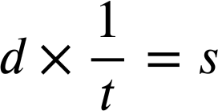
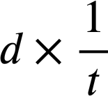
Rearranging multiplicative relationships
Rearranging from ‘product over factor’ with algebraic variables in the equation is no different.
i.e. Rearrange
Half of 10 is 5
Half of 10 is 5
× t = s × t
× 2 = 5 × 2
Multiply by the reciprocal of a half
d = s × t
10 = 5 × 2

Slide 29
Rearranging multiplicative relationships
Rearranging from ‘product over factor’ with algebraic variables in the equation is no different.
i.e. Rearrange
Again the product is anchored in the numerator position. The factors change positions.
× t = s × t
d = s × t
d = t × s

Slide 30
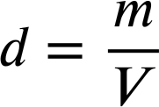
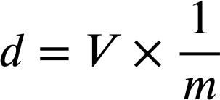
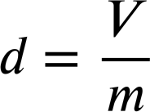
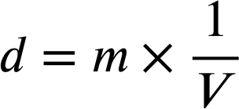
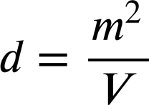
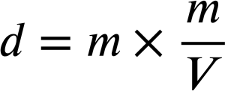
Rearranging multiplicative relationships
Which of these is the correct manipulation of this equation?

Slide 31
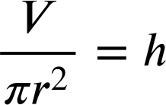
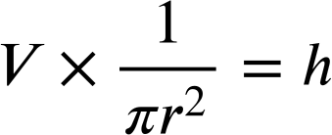
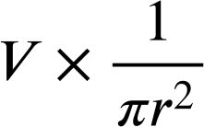
Rearranging multiplicative relationships
Rearranging from ‘product over factor’ with multiple terms grouped as one term is no different.
i.e. Rearrange
V = 𝜋r²h
× 𝜋r² = h × 𝜋r²
V = 𝜋r²h

Slide 32
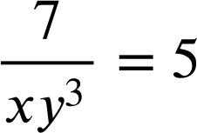
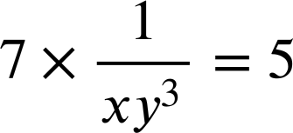
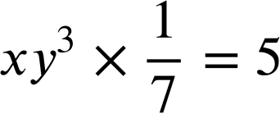
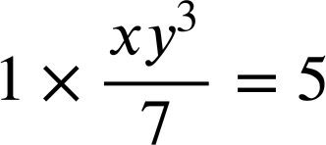
Rearranging multiplicative relationships
Which of these is the first step to rearranging this equation?

Slide 33
Rearranging multiplicative relationships
What is the next step to rearranging this equation?
on both sides.
on both sides.
on the LHS only.
÷ xy³
× xy³
Multiply both sides by the reciprocal xy³
× xy³

Slide 34
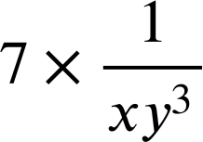
Rearranging multiplicative relationships
What is the our final rearrangement?
5 = 7xy³
7 = 5 × xy³
Not fully simplified
× xy³ = 5 × xy³
7 = 5xy³

Slide 35
Rearranging multiplicative relationships
What is the our final rearrangement?
5 = 7xy³
7 = 5xy³
7 = 5 × xy³
When you become really confident you could do this in one quick step, × xy³
7 = 5xy³

Slide 36
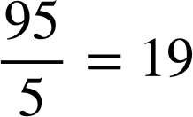
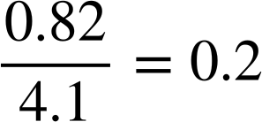
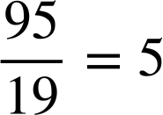
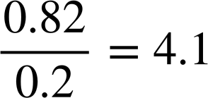




Rearranging multiplicative relationships
1) Write the family of rearrangements for the below equations.
a)
b)
19 × 5 = 95
0.2 × 4.1 = 0.82
5 × 19 = 95
4.1 × 0.2 = 0.82
c)
d)
7 × y = 56
P = F × A
y × 7 = 56
P = A × F

Slide 37








Rearranging multiplicative relationships
2) Lucas is rearranging equations.
a)
I just ‘swap positions’ in the equation.
can swap to
b)
can swap to
In each case decide if Lucas is correct and write a sentence to justify your decision.
c)
can swap to

Slide 38



Rearranging multiplicative relationships
3) Rearrange each equation into the form a × b = c
a)
b)
c)

Slide 39
Rearranging multiplicative relationships
1) Write the family of rearrangements for the below equations.
a)
b)
19 × 5 = 95
0.2 × 4.1 = 0.82
5 × 19 = 95
4.1 × 0.2 = 0.82
c)
d)
7 × y = 56
P = F × A
y × 7 = 56
P = A × F

Slide 40
Rearranging multiplicative relationships
2) Lucas is rearranging equations.
a)
Both are rearrangements of 8 × 9 = 72 where 72 is the product.
can swap to
b)
can swap to
In each case decide if Lucas is correct and write a sentence to justify your decision.
c)
can swap to

Slide 41
Rearranging multiplicative relationships
2) Lucas is rearranging equations.
a)
Both are rearrangements of 8 × 9 = 72 where 72 is the product.
can swap to
b)
Both are rearrangements of bh = 5 where 5 is the product.
can swap to
c)
One is a rearrangement of 2x = 13 and the other is a rearrangement of 13x = 2
can swap to

Slide 42
Rearranging multiplicative relationships
You may have written some advice for Lucas:
It is important to rearrange equations correctly.
It is not just about swapping the terms around.
I just ‘swap positions’ in the equation.

Slide 43





Rearranging multiplicative relationships
3) Rearrange each equation into the form a × b = c
a)
b)
c)
× 3yz = 4z² × 3yz
× 8 = y × 8
× 3y = y × 3y
5x = 12yz³
x = 8y
x = 3y²

Slide 44


Multiplicative relationships between terms
Multiplicative relationships between variables can be written in a number of different ways.
For example, from the equation we can find a family of rearrangements.
15 = c × d
15 = d × c

Slide 45

© Oak National Academy 2024.
Produced in partnership with Mathematics in Education and Industry.
Licensed on the Open Government Licence v3.0, except where otherwise stated. See Oak terms and conditions.

